Slide 1
Non-local Students Orientation Day 2024 非本地生迎新日2024
30 August 2024 (Friday)
Mainland and International Affairs Office
內地及國際事務處

Slide 2
Introduction of
Vocational Training Council (VTC)

Slide 3
Agenda
Hong Kong – At a GlanceOpening Speech
Introduction of VTC & MAIO
Introduction of SDO
Talk on Anti-drugs
Talk on Anti-fraud
Academic Briefing
Living in HK
Q&A

Slide 4
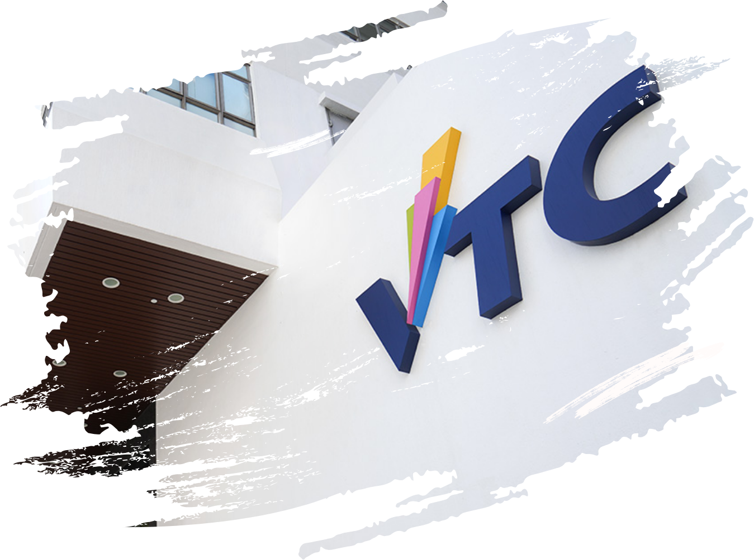
Vocational Training Council (VTC)
A statutory organisation established in 1982
The leading vocational and professional education and training (VPET) provider in Hong Kong
Council membership comprises senior government officials and industry representatives
4

Slide 5















14 Member Institutions
Provide seamless progression pathway for career advancement and lifelong learning
5

Slide 6


Recognition under
Hong Kong Qualifications Framework
QF Level
Doctorate Degree
Master Degree, Postgraduate Diploma, Postgraduate Certificate
Bachelor Degree
Higher Diploma / Associate Degree
Diploma
Certificate
Certificate
VTC Programmes
Postgraduate Programmes
in partnership with overseas universities
Degree and Top-up Degree
Higher Diploma
Diploma of Foundation Studies
Diploma of Vocational Education
Diploma of Vocational Baccalaureate
Diploma Programmes
Industry Certificate
Junior General Purpose Rating
6

Slide 7


VTC Member Institutions Accepting International Students
Higher Diploma (HD) (2-year)
Hong Kong Institute of Vocational Education (IVE)
Degree (4-year)
Hong Kong Design Institute (HKDI)
International Culinary Institute (ICI)
Technological and Higher Education Institute of Hong Kong (THEi)
Hong Kong Institute of Information Technology (HKIIT)
7

Slide 8
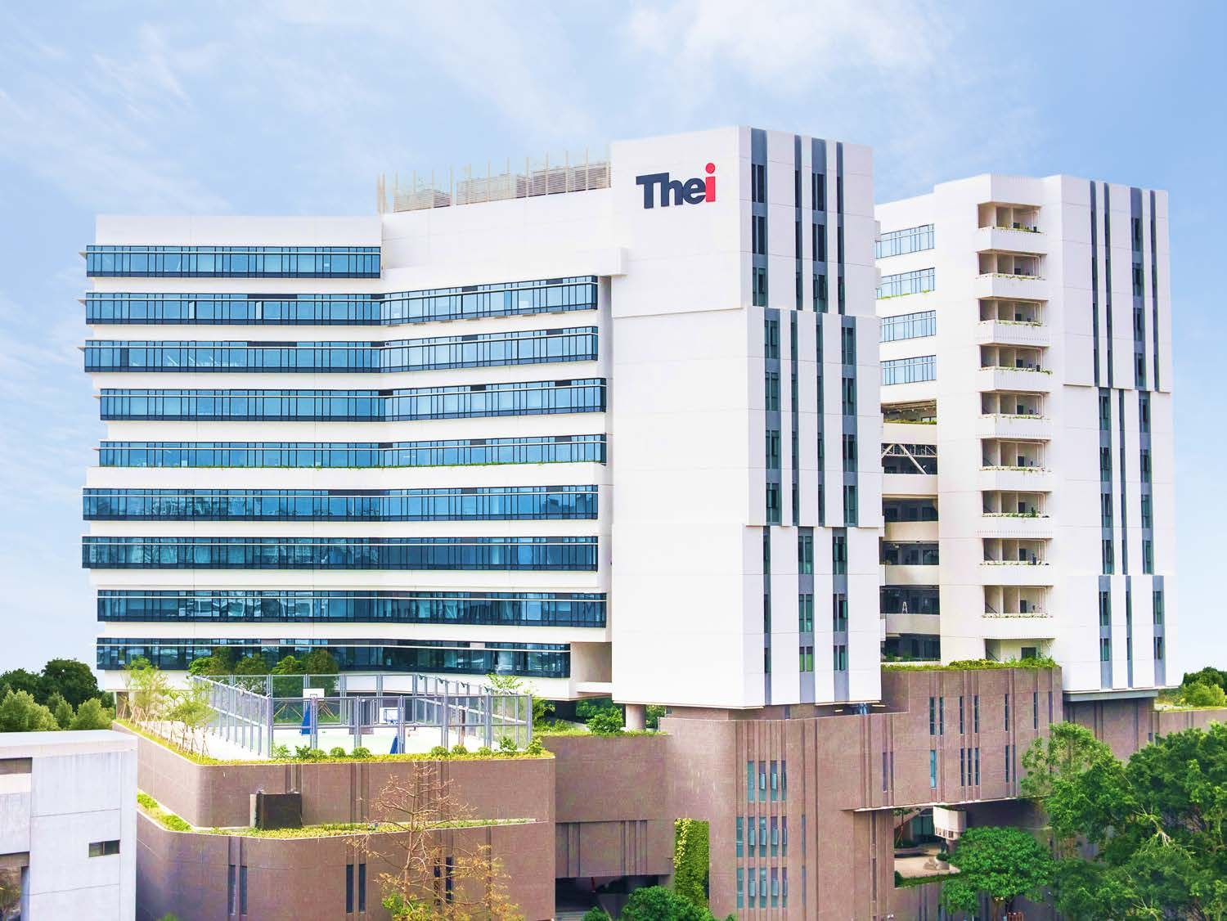
Technological and Higher Education
Institute of Hong Kong (THEi)
Provides "Applied Science-Oriented" degree programmes
7 Academic Areas:
  Product and Fashion Designs
  Sports and International Events Management
  Digital Construction and Building Services,
  Horticulture, Arboriculture and Landscape Management,
  Chinese Medicine and Food Science
  Hotel Management and Culinary Arts
  Technology and Digital Technology
  Innovative Business
  Features a fine balance of theory, practice, general education and industry/profession-specific modules

Slide 9
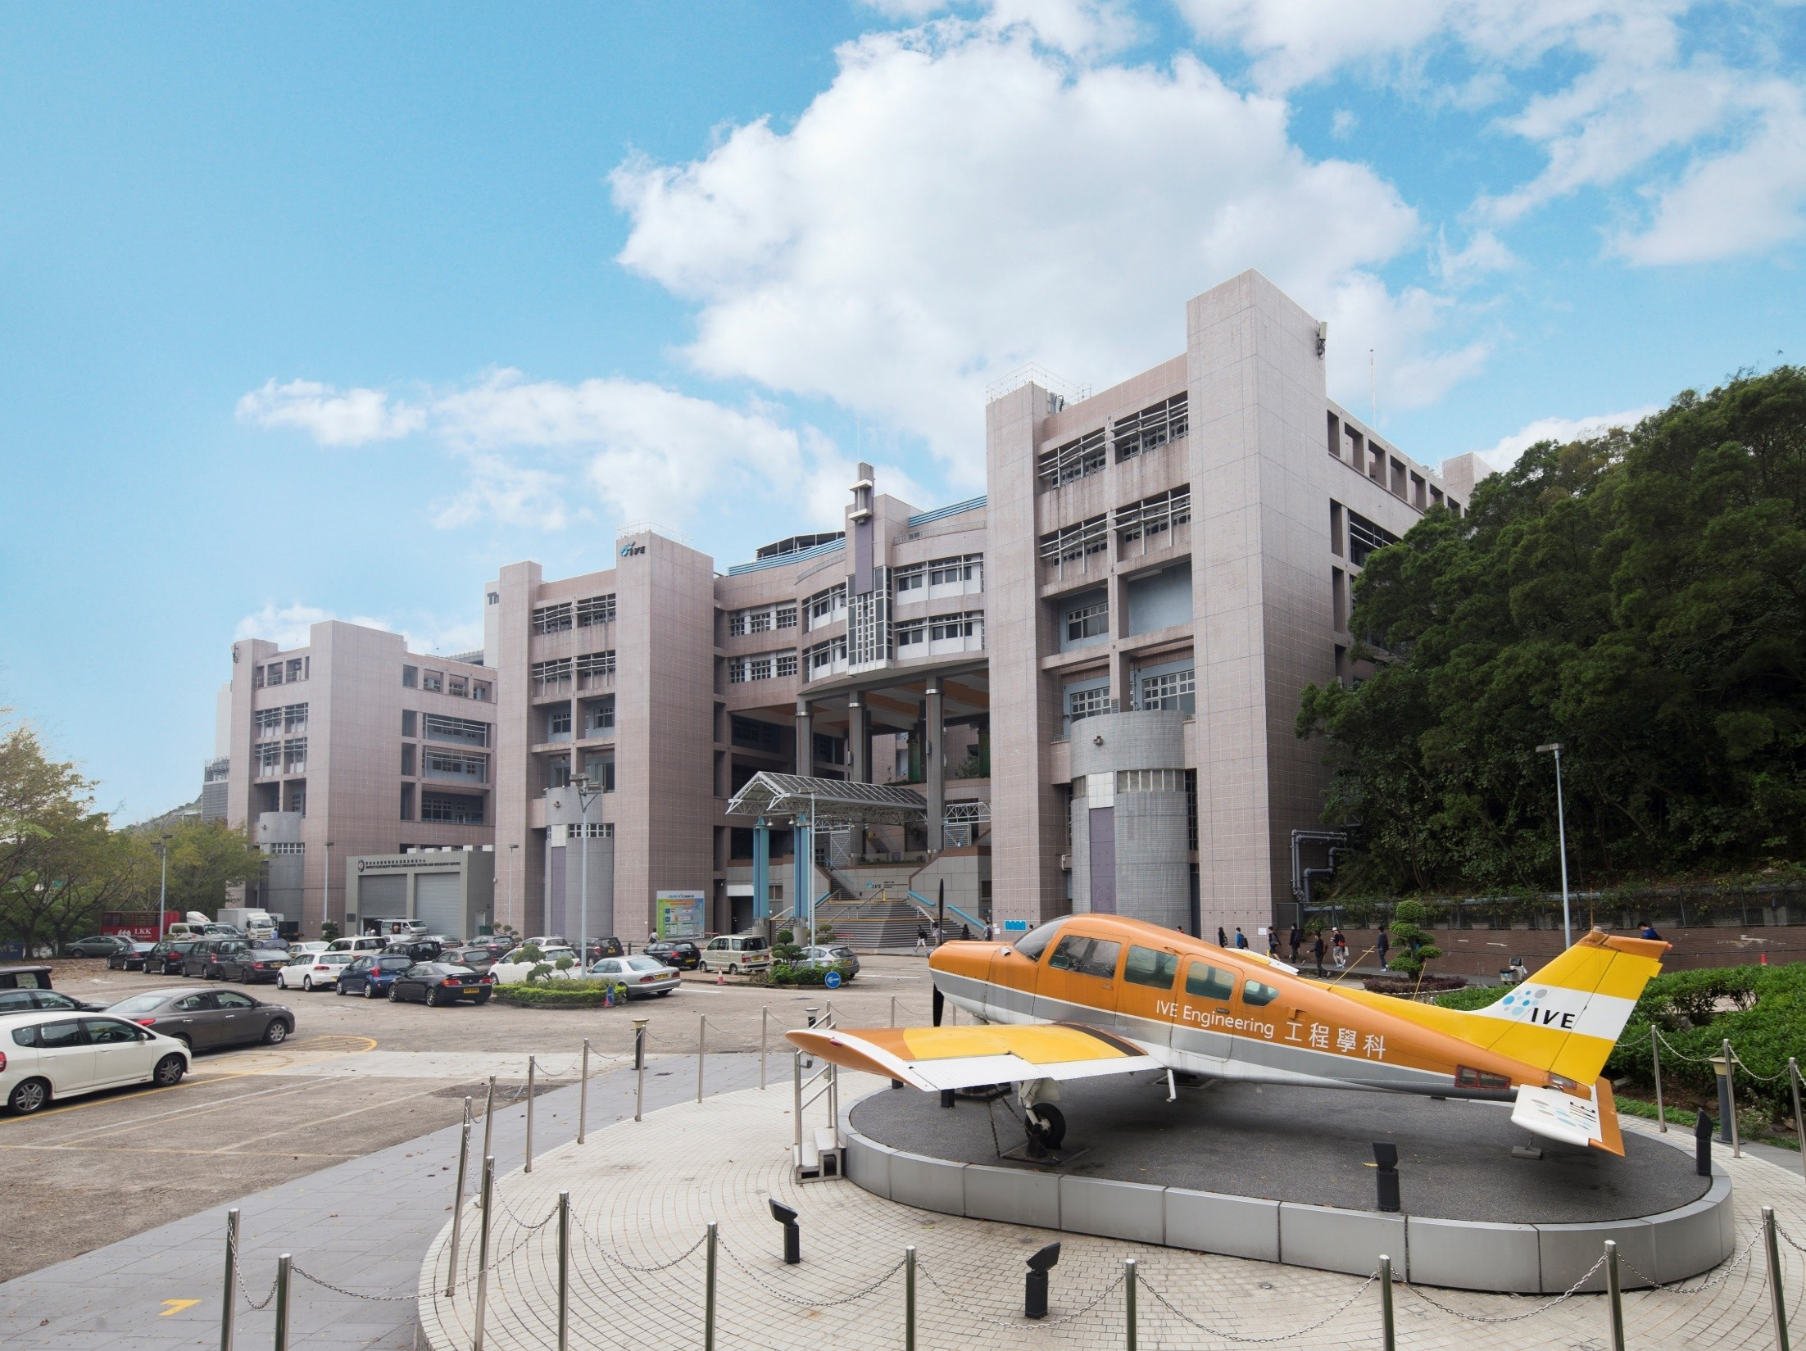
Hong Kong Institute of Vocational Education (IVE)
Offers Higher Diploma (HD) programmes covering an array of disciplines
9 Campuses around Hong Kong

Slide 10
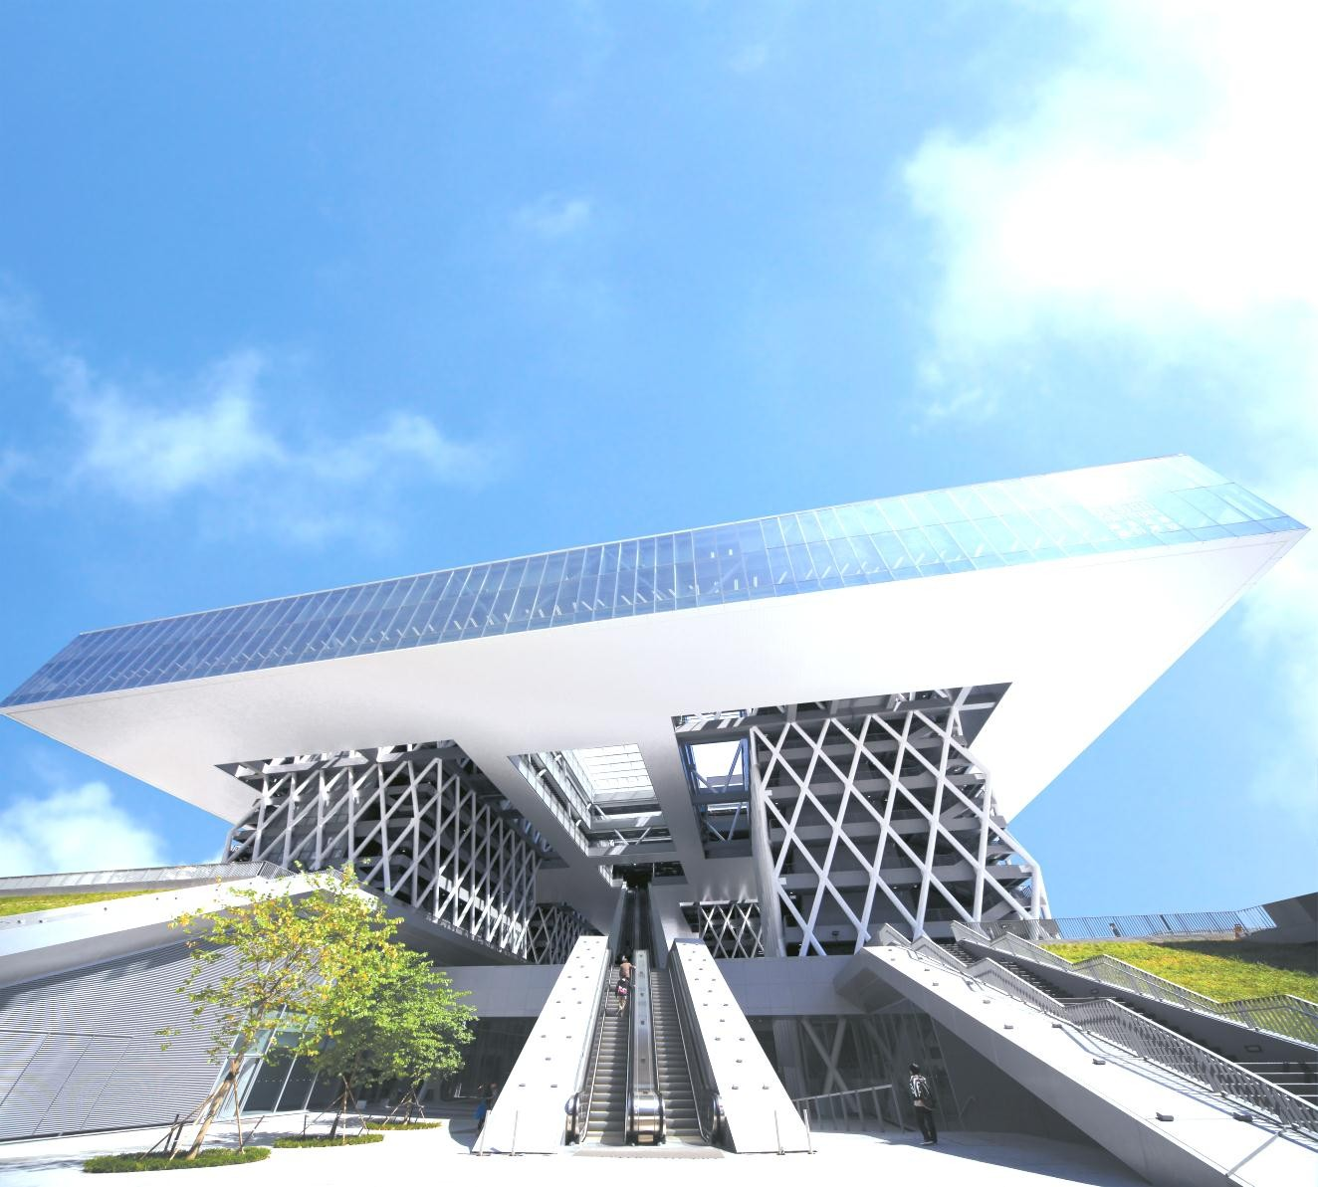

Hong Kong Design Institute (HKDI)
Most influential education institution in Hong Kong
Opened in 2010 for HKDI and IVE (Lee Wai Lee)
Four Academic Departments:
  Architecture, Interior and Product Design
  Communication Design
  Digital Media
  Fashion & Image Design

Slide 11
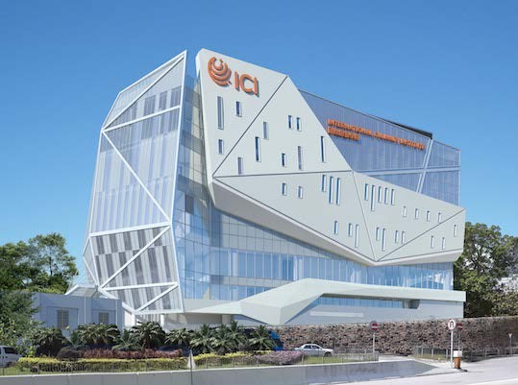
International Culinary Institute (ICI)
Provide a wide range of professional culinary programmes including Chinese, European, Mediterranean, American, Asian and Middle Eastern cuisines
Programme areas:
  Baking and Pastry
  Culinary Arts
  Theme Park and Event Management
  Wine and Beverage

Slide 12
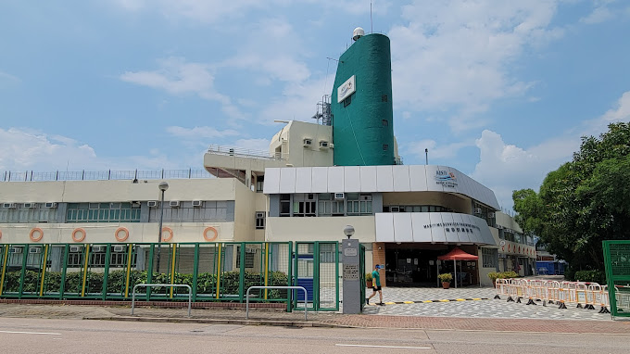
The Maritime Services Training Institute (MSTI)
Established in 1988
Provide a wide range of training courses for new entrants, in-service seafarers, and employees of maritime industry

Slide 13
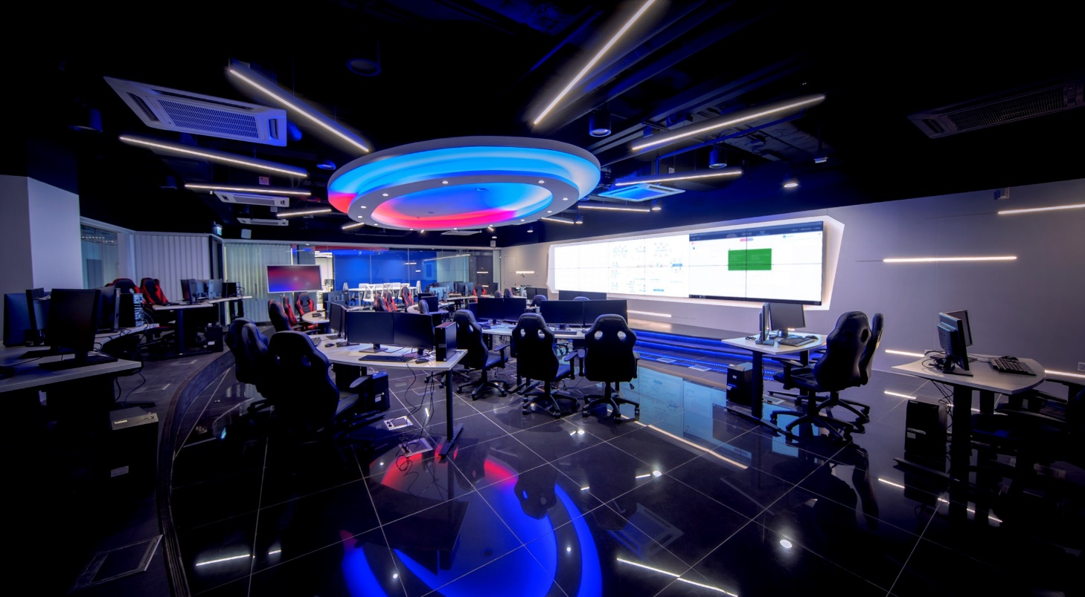
Hong Kong Institute of Information Technology (HKIIT)
Established on 1 November 2023
HKIIT offers comprehensive IT programmes in areas like AI, Cybersecurity, Data Science, Web 3.0, and IoT, aiming to develop well-rounded IT talent.
Main campus is located in Tsing Yi , with additional programmes available at various IVE campuses such as IVE(Chai Wan), IVE (Kwun Tong), IVE (Lee Wai Lee), IVE(Sha Tin) and IVE (Tuen Mun).

Slide 14
Introduction of Mainland and International Affairs Office

Slide 15




Who are we?
Non-local Student Admissions
Mainland and International Affairs Office (MIAO)
Establish and enhance collaborations between VTC and Mainland and International VPET programme providers and industries
Build a diversified talent pool and unleash the strength and potential of Hong Kong youths for career aspirations in different industries in the Mainland and overseas countries
Explore and engage with partners in the Guangdong-Hong Kong-Macao Greater Bay Area to open up more cooperation opportunities
Support the development of the VTC Mainland Office.
Non-local Industrial Attachments
Student Study Trips
International Events

Slide 16


We are your first stop for…
Health insurance
Student visa and immigration- related policies

Slide 17






For these needs…
Academic-related enquiries
Programme Leaders / Instructors
Tuition fee-related enquiries
Registry / Campus Secretariat
Campus-related enquiries
Registry / Campus
Secretariat
Psychological counselling Student Development Office
Hall-related enquiries
Hall Management Office
Computer account / network-related enquiries
ITSD

Slide 18




4 Most Important Advice
Check your VTC student email regularly
Take initiative towards your student life
Be responsive
Read documents/emails carefully

Slide 19

Semester 1, AY2024/25
School commencement on 2 Sep 2024
Engaging in learning activities without a valid student visa is a violation of immigration laws.
MIAO is actively monitoring the progress of students' visa applications with the Hong Kong Immigration Department.
For students who have not obtained their student visas before the start of the semester, your programme leader or class tutor or module teachers will reach out to you individually via email to provide detailed information about the class arrangements and offer guidance.

Slide 20

Keeping in Contact
Tel: +852-2836 1784
Email: iss@vtc.edu.hk
Official information channel
is still your student email! @stu.edu.hk

