Slide 1
Non-local Students Orientation Day 2024 非本地生迎新日2024
30 August 2024 (Friday)
Mainland and International Affairs Office
內地及國際事務處

Slide 2
Living in Hong Kong
活在香港

Slide 3

Living in Hong Kong 活在香港
Hong Kong Identity Card
Bank Account
Payment
If You Are Sick
In Case of Emergency
香港身份证
银行账户
付款
生病
紧急情况

Slide 4
Hong Kong Identity Card
香港身份证

Slide 5
Bank Account
银行账户

Slide 6






Bank Account 银行账户
Major banks in Hong Kong:
  Bank of China (Hong Kong) Ltd.
  Hang Seng Bank, Ltd.
  Hong Kong & Shanghai Banking Corporation Ltd. (HSBC)
  Standard Chartered Bank (HK) Ltd.
  The Bank of East Asia, Ltd.
  CitiBank Hong Kong Ltd.
香港主要银行包括:
  中国银行
  恒生银行
  香港上海汇丰银行
  渣打银行
  东亚银行
  花旗银行
It is recommended that you open a local bank account for convenient financial services, e.g. money transfer from family, payment of tuition fees by bank transfer.
建议开设一个本港银行账户, 方便日后理财
(例如家人可汇生活费给你, 银行转账交学费等)。

Slide 7
Bank Account 银行账户
Choose a local bank with branches in your home country/region; or close to your campus / accommodation for convenient services.
Bring your Hong Kong identity card, student card, passport, visa/entry permit and proof of residence (home country/region and Hong Kong) for account opening.
For details, please enquire with the bank.
请选择一间在你的原居地有分行，或靠近你的院校/住所的本地银行，方便
理财 。
通常银行在开设账户时会要求你提供香港身份证、学生证、中国居民身份证、护照/往来港澳通行证、签证/进入许可证、地址证明 (原居地及香港)。
详情请向银行柜台职员查询 。
Notes:
Highlight that both home country and Hong Kong residential address proof are required

Slide 8
Bank Account 银行账户
Recommended acceptable Address Proof (any of the following) in home country and Hong Kong:
Utility, rates or tax bills
Bank or credit card statements
Letters/correspondence issued by government , other public bodies, banks or insurance companies
Mobile phone or pay TV statements
Rental agreements showing the address and having your name as one of the contracting parties
Identity Card, passport or driving licence with your photo on it, which shows your address in the home country
A land search report on the address which confirms that you are the owner of the property
Address proof of an immediate family member plus a written confirmation from the immediate family member that you are living at that address
可接纳的地址证明（下列任何一项）:
水费、电费或税金单
银行或信用卡月结单
政府、事业单位、银行或保险公司发出的信件或文件
手机或收费电视月结单显示你是租户的租约
印有你居住地址的身份证、护照或驾驶执照
物业查册、房产证
家人的住址证明及声明书

Slide 9
Bank Account 银行账户
Notes:
Documents required for bank account opening may vary between banks.
Address proof must be recent (i.e. issued within 3 months).
If documents are not in English/Chinese, you will need a translated English version translated by a legal/authorised translator.
There are additional requirements for applicants aged under 18.
备注:
不同银行的申请开户文件可能有异。
住址证明必须为最近3个月内。
如文件非英文/中文书写, 必须提交英文翻译本。
十八岁以下申请人有额外要求。

Slide 10
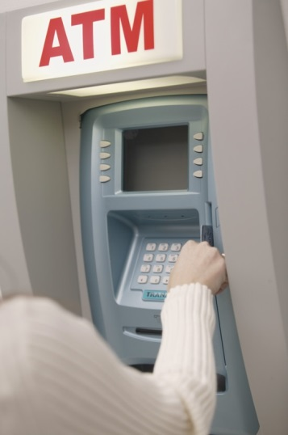
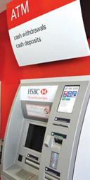
Bank Account 银行账户
Make sure you completely understand the charging mechanism of the type of bank account before you choose it.
Apply for an Automated Teller Machine Card (ATM Card) from your bank.
ATM machines can be found everywhere and provide 24-hour cash withdrawals with your ATM or credit card.
在开设银行账户前，请确保你已经完全理解它的收费模式。
向银行申请一张可在ATM柜员机上提款的银行卡。
自动柜员机随处可见，并提供24小时服务的银行卡或信用卡的现金提取服务。
Notes:
Highlight the lack of debit-cards

Slide 11
Payment
付款

Slide 12
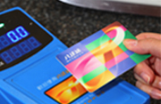

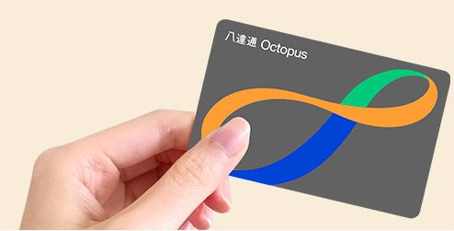
Payment 付款
Octopus: one of the most convenient payment methods
Stored value electronic card widely used in Hong Kong for public transport and purchases in convenience stores & shops.
Available for sale at any MTR Customer Service Centre. $150/card ($100 stored value and $50 refundable deposit). Octopus can be reloaded.
Eligible students can also apply for a Personalised Student Octopus Card to enjoy concessionary fares. For details please enquire with the Student Development Office (SDO) or Campus Secretariat (CS).
八达通：其中一种最便利的付款方式
「八达通」卡是一张电子储值卡，适用于交通工具、便利店、商户购物、自助贩卖机、康乐设施等。
可于任何一个港铁站客服中心购买，每张150元(100元为面值， 50元为可退回之按金)，可以在全港数千个地点增值。
合资格学生可以申请 “学生八达通” 享受乘车优惠，详情向学生发展处或学院秘书处查询 。
Source: Octopus

Slide 13
If You Are Sick
生病

Slide 14


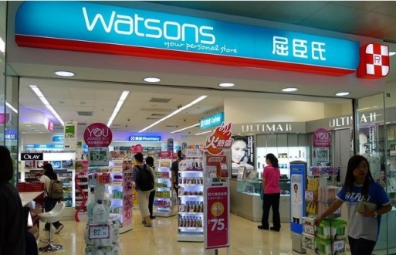
If You Are Sick 生病
If you are A BIT unwell,
You can purchase medicines through registered pharmacies with a special sign “Rx” displayed outside the shops.
Big chain stores e.g. Watson’s, Mannings provide pharmacist services.
若身体不适，
可以到有注册药剂师的药房购买药物，药剂师会建议你应吃哪种药。此类药房外面亦会悬挂特别标记「Rx」
以做识别。
大型连锁店例如屈臣氏，万宁等均提供药剂师服务。
Notes:
Including antibiotics that students may be used to requiring a prescription for.

Slide 15
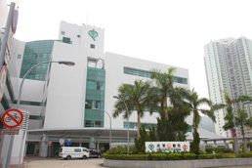
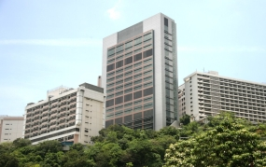
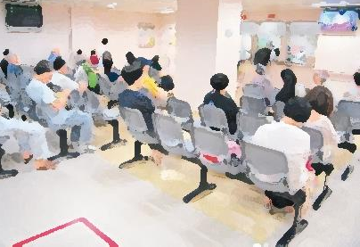
If You Are Sick 生病
Where can I find a doctor?
http://www.hkdoctors.org/
Medical doctors must be registered to practice in Hong Kong.
Public health service is much cheaper than the private but the waiting time is very long.
哪里有医生？
http://www.hkdoctors.org/
香港所有执业医生都必须注册。
公立医院的医疗服务收费比私家医院便宜很多，但轮候服务的时间亦较长。
Source: Hospital Authority, HKSAR

Slide 16
If You Are Sick 生病
Services | Public | Public*/Private
Accident & Emergency | $180 per attendance | $1,230+
In-patient | $120 per day + $75 admission fee | On an individual (service) basis $5,100-6,650 per day or more
General out-patient | $50 per attendance | $445+
Specialist out-patient care | $135 for first visit, $80 per visit thereafter, $15 per drug item | $1,190 - $2,210
Dressing or injection | $19 per attendance | $100 - $360
24-hour emergency and out-patient | Provided by most of the public hospitals | Provided by some private hospitals
服务 | 公立 | 公立*/私立
急症室 | 每次180元 | $1,230+
住院服务 | 每天120元、入院费75元 | 逐项收费，每天$5,100 - $6,650元或更多
普通科门诊 | 每次50元 | $445+
专科门诊 | 首次诊症135元、之后每次诊症80元、每种药物收费15元 | $1,190 - $2,210
专科敷药及注射 | 每次19元 | $100 - $360
24小时急症服务 | 大部分公立医院提供 | 只有部分私家医院会提供
* Low price listed is the cost of
public healthcare for non-
eligible persons.
* 供非符合资格人士之公众收费。
Notes:
Updated for 2018 from Hospital Authority website: http://www.ha.org.hk/visitor/ha_visitor_index.asp?Content_ID=10045&Lang=ENG

Slide 17

If You Are Sick 生病
Who can help?
During Class | Seek help from teachers
In Institution | Contact Campus Secretariat or Registry / Student Development Office
In VTC Dormitory | Contact Hall Manager / Dormitory Staff
Elsewhere in Hong Kong | Call emergency hotline
谁能帮助你？
在上课中 | 寻求在场老师会协助
在院校 | 联系学院秘书处或学生发展处
在宿舍 | 联系舍监或宿舍办事处
在香港其他地方 | 拨打紧急求助热线

Slide 18
If You Are Sick 生病
Medical Insurance
VTC has purchased basic medical insurance for every full-time non-local student (ICI, IVE, HKDI & THEi), including hospitalisation & out-patient services. (Effective until 27 Aug 2025) You are strongly advised to purchase additional insurance at your own cost.
Refer to the insurance service provider, BOCG Insurance website 中銀集團保險有限公司 (bocgins.com) for details. Related information can also be found on the MIAO website.
You will be notified shortly when your Medical Card is issued.
医疗保险
院校已替每位来自内地和国际的全日制学生购买基本医疗保险，包括住院医疗及门诊医疗 (保障有效期至2025年8月27日)。 我们建议学生自行购买额外保险 。
保险计划详情请查看投保保险公司 – 中银集团保险网页 中銀集團保險有限公司 (bocgins.com) ，有关资料已在内地及国际事务处的网页内列出。
医疗卡将于稍后发出，您将很快收到通知
The medical card is still being prepared. Once notified, students can go to the MIAO to receive the medical card in person.
医疗卡还在准备中，待收到通知后，学生可亲身到内地及国际事务处领取医疗卡。

Slide 19

If You Are Sick 生病
To see a doctor
Show your HKID Card /passport for registration. Visit any clinic on the Panel Doctor List and present your medical card.
If you want to visit a doctor not on the Panel Doctor List, you have to pay first and submit a Claim Form to claim for reimbursement. (Please check the official web page of BOCG Insurance regularly for any revisions and/or amendments that may be made.)
看医生
前往医院或诊所看病时，你需出示香港居民身份证/ 护照做登记。 到网络医生的诊所看病，请出示你的医疗卡。
如你想到网络医生以外的诊所看病，你需要先付费，然后填写索赔申请表索赔。
(请定期浏览中银集团保险网页以查阅任何修改及/或修订。)

Slide 20

If You Are Sick 生病
To have surgery in hospital
You have to pay first and submit a Claim Form to claim for reimbursement. There is a claim limit for each category of hospitalisation benefit.
Please check with the insurance service provider by calling the Hotline for details before admission to hospital. You may also ask MIAO for assistance.
入医院做手术
你需要先付费，然后填写索赔申请表索赔，每个住院医疗项目均有最高赔偿上限。
请在入院前，先致电保险公司热线查询赔偿详情，或可向内地及国际事务处寻求协助。

Slide 21

If You Are Sick 生病
To claim for reimbursement
You can download the Claim Form from the MIAO Website. Complete the Claim Form and send the Form and related documents, such as medical certificate, by post to the insurance company.
The insurance company will issue you a cheque for reimbursement of claims. You therefore need to have a bank account in Hong Kong to receive reimbursement.
申请索赔
你可以从内地及国际事务处的网页下载索赔申请表。填妥索赔申请表并把申请表连同有关文件,例如医生证明邮寄到承保的保险公司。
保险公司会以支票形式向你支付赔偿, 所以你必须在香港开设银行账户才可以取得赔偿。

Slide 22
In Case of Emergency 紧急情况
Emergency
Lost wallet or valuables | Report to police
Lost ATM / credit card | Report to your card issuer as quickly as possible
Lost Student Octopus | Call the 24-hour hotline 2266 2266 to report the loss and stop further transactions using the lost card
Lost passport | File a report at the nearest police station. Contact your consulate for replacement
Lost HKID Card | Report to any Registration of Persons Office and apply for a replacement within 14 days. (Return original if destroyed, damaged or defaced)
Lost Entry Permit | Mainland students losing Entry Permit should contact MIAO for procedures to apply for a replacement
紧急情况
财物失窃 | 立即向警署报案
如遗失提款卡、信用卡 | 尽快向银行办理报失
遗失八达通 | 立即致电24小时八达通报失热线2266 2266以停止接受该八达通的交易
遗失护照 | 可前往邻近的警署办理“报失财物”记录，然后联系中华人民共和国外交部驻香港特别行政区特派员公署或驻香港领馆申请办理补发手续
遗失香港身份证 | 你必须在14天内向人事登记办事处报告及申领新证
遗失《往来港澳通行证》 | 内地学生若遗失通行证需向内地及国际事务处查询补领手续

