Slide 1
Non-local Students Orientation Day 2024 非本地生迎新日2024
30 August 2024 (Friday)
Mainland and International Affairs Office
內地及國際事務處

Slide 2
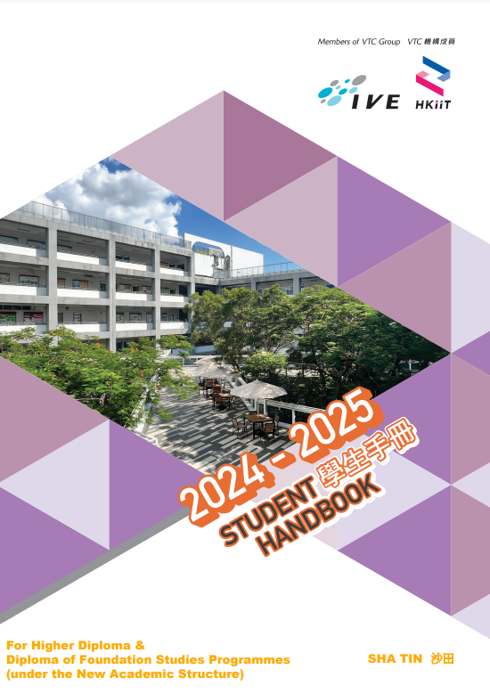

Student Handbook 学生手册
Notes:
The student handbook is extremely important and useful, so I strongly advise all of you to read it.

Slide 3


Student Handbook 学生手册
Contains essential information such as student-related academic policies and regulations (including module exemption and transfer of study), fees and charges and student support services and facilities.
Please study carefully and observe all the information stated.
包含很多重要信息如学术政策和规则(包括学科/单元豁免和转读课程/院校)、费用及收费政策以及学生支持服务和设施等。
请仔细阅读手册内的所有内容。

Slide 4
Rules 规章制度
No plagiarism & respect for Intellectual Property
Academic honesty:
  Cheating may lead to disciplinary action and penalties
  e.g. Awarded ZERO mark, suspension for one semester or one year, or even immediate expulsion
严禁抄袭 及 尊重知识产权
学术诚信要求
  考试作弊有可能受到纪律处分
  例如，分数为0分；停课一学期或一学年或甚至实时开除

Slide 5
Rules 规章制度
Some academic rules of Higher Diploma (HD) programmes
Attendance: 70% (attendance below requirement may result in failure of modules)
Pass mark: 40%
No re-assessment
高级文凭课程的部分学术要求
出席率不少于70% (不达标可能导致该单元不及格)
及格线为满分之40%
不提供补考
Notes:
Remember to bring along your student id card
Sick during exam >> visit clinic and take medical cert

Slide 6
Law and Regulation 法律条文
If your enrolment is terminated, your Student Visa will also be terminated and you will need to return to your home country. Under the following situations, your enrolment will be terminated :
如以下情况导致终止学籍，你的学生签证将被院校自动取消，并且你必须返回你的原居地：
Your CGPA < 1.0 at the end of each Academic Year
于学年结束时累积平均积点分数低于1.0
You have not turned up to scheduled activities for 4 consecutive weeks.
连续4个星期没有如期参加课程或相关活动
Please refer to your Student Handbook for more information. 有关学院规则，请参阅学生手册。

Slide 7
Laws & Regulations 法律条文
Must register for an Identity Card (HKID Card) within 30 days of arrival at any Registration of Persons Office.
No fee is payable on first registration for an identity card. Please make an appointment through 2598 0888 or www.gov.hk/icbooking.
When register for an HKID Card, you must produce your valid travel document, passport, visa/entry permit.
必须在抵港30天之内，前往入境处辖下任何一间人事登记处登记领取身份证。
首次登记身份证费用全免。需事先与人事登记处预约后，再前往登记领取。预约方式如下：2598 0888 or www.gov.hk/icbooking
申请登记领取香港身份证时，必须出示你的有效旅行证件，例如往来港澳
通行证，签证/进入许可等。

Slide 8
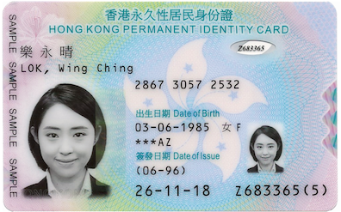
Laws & Regulations 法律条文
Must carry your HKID Card at all times.
Hong Kong police have the right to stop you and request for your proof of identity at any time.
香港身份证应该随身携带。
警员有权要求你出示身份证明。
Source: Immigration Department, HKSAR
Notes:
Photo source: https://www.immd.gov.hk/eng/services/hkid/smartid.html

Slide 9

Laws & Regulations 法律条文
You need to complete your study within the normal programme duration: Higher Diploma (2 years)
You are not allowed to change your programme of study or institution without prior approval from the Immigration Department of Hong Kong.
你应在常规修读期限内完成学业，通常修读期限：
高级文凭 (2年)
在未得到香港入境事务处事先批准之前，你不可自行转专业/院校。

Slide 10
Laws & Regulations 法律条文
For students from Mainland, Macao and Taiwan, if you cannot complete your programme within the normal duration, consideration may be given to extend your stay for up to one year so as to complete the programme.
来自中国内地、澳门及台湾的学生，如果在通常修读期限内 (高级文凭一般2年完成) 未能顺利毕业，一般最多可获延期逗留一年，以便继续修毕该课程。
Notes:
Repetitive information about the programme duration (just stated on the previous slide) was removed

Slide 11

Laws & Regulations 法律条文
You must abide by the Hong Kong Laws and are responsible for your own actions. If the law is violated, you will be prosecuted and escorted out of HK.
Non-local students are NOT allowed to take up any employment, whether paid or unpaid; or establish or join in any business, except under exceptional circumstances.
你应遵守香港法律并对自己的行为负责！如有违反，会被检控及遣离香港 。
除特殊情况外，非本地学生不得接受有薪或无薪的雇佣工作，或在香港开办或参与任何业务。
Notes:
Photo source: https://pixabay.com/en/hammer-books-law-court-lawyer-719061/
Free for commercial use. No attribution required

Slide 12
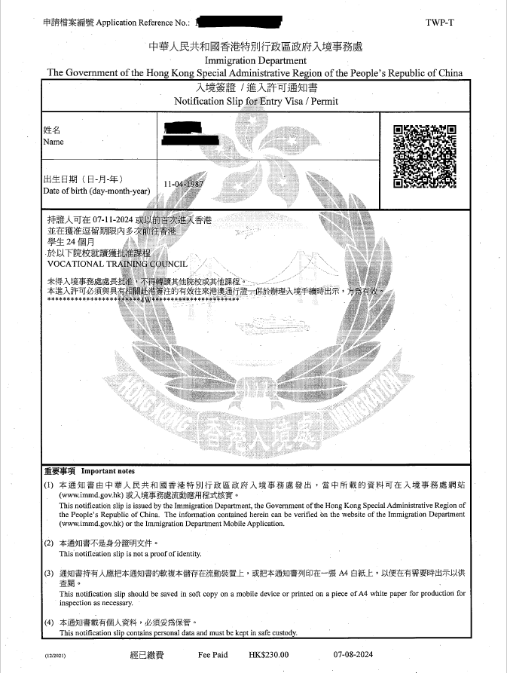
Laws & Regulations 法律条文
Leave Hong Kong on/ before the expiry of stay granted by the HK Immigration Department.
须在入境事务处所批准的逗留期限届满时/ 以前离港 。

Slide 13

Campus Restrictions
校园严禁事项
Gambling and betting
Smoking within campus premises (a maximum fine of HK$5,000)
Consuming alcoholic drinks within campus without permission of the Campus Principal
Viewing, uploading and downloading obscene pictures or movies
Taking attendance for other students
任何形式的赌博
校园内吸烟（最高罚款达港币5,000元）
除非获得院长批准，否则校园内一律不准饮酒
观看、上载或下载不雅图片或电影
代其他同学点名
And more... ( please read your Student Handbook)
其他...（请参考你的学生手册）

Slide 14

Tuition Payment 缴交学费
AY2024/25 | 2nd Tuition Instalment Due Date
2nd Semester | End of December 2024
2nd Installment Tuition Bill
  Download from MyPortal

Slide 15
Tuition Payment 缴交学费
Payment Means
  ATM/JETCO/PPS
  Internet Banking
  Pay at Bank
Payment Means outside Hong Kong
  Telegraphic Transfer (it will take a longer time for verification)
  Internet Banking
缴费方法：
  自动柜员机/银通/缴费灵
  网上银行
  到银行分行付款
海外缴费方法：
  海外电汇(需较长时间核实)
  网上银行

Slide 16
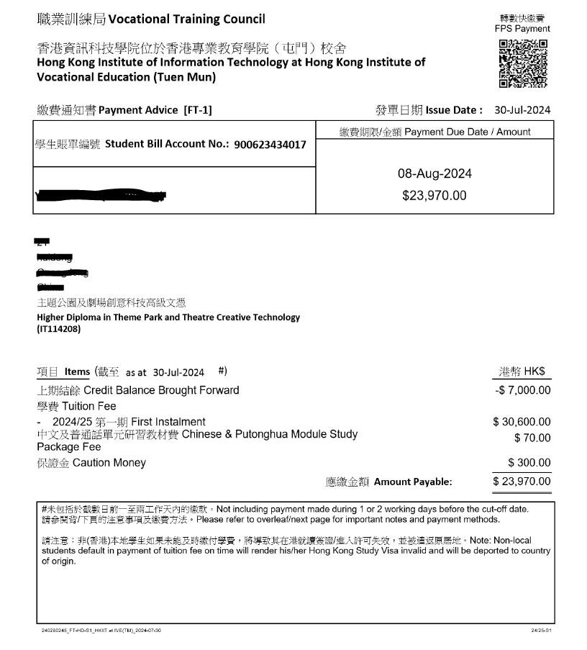
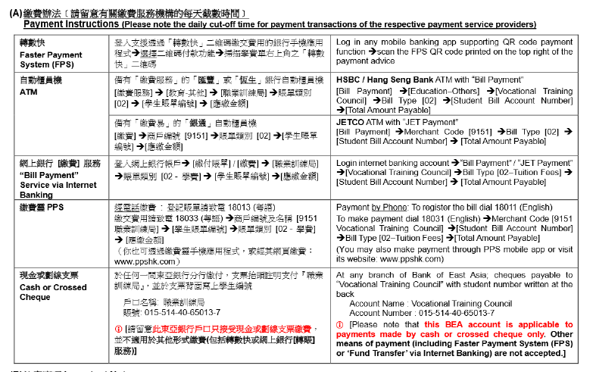
Tuition Payment 缴交学费
Settle tuition fee according to the payment means (i.e. designated account/bank)
根据缴费单上的缴费方法交学费

Slide 17

Tuition Payment 缴交学费
If you do not settle tuition fee to the designated bank account…
  the transaction may not be automatically recognised and updated in your student record
  you will receive notifications for outstanding balance
  you will be unable to access to some functions on MyPortal due to non-payment (e.g. academic transcripts)
如你没有缴费到指定银行账户的话…
  系统未能自动识别款项
  你将收到未缴费通知
  你将因逾期缴费而未能使用部分MyPortal功能（如：查询成绩单）

